Slide 1
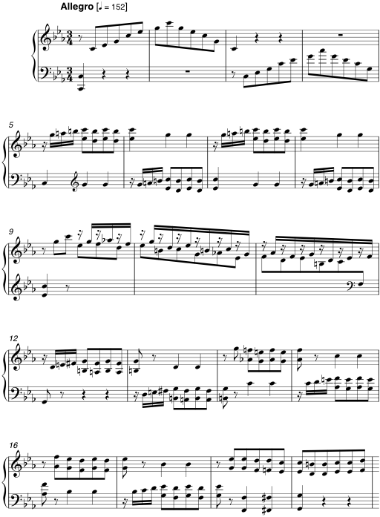
A
A
B
B
B
B
C
C
B
D
B
B
D
B

